Slide 1
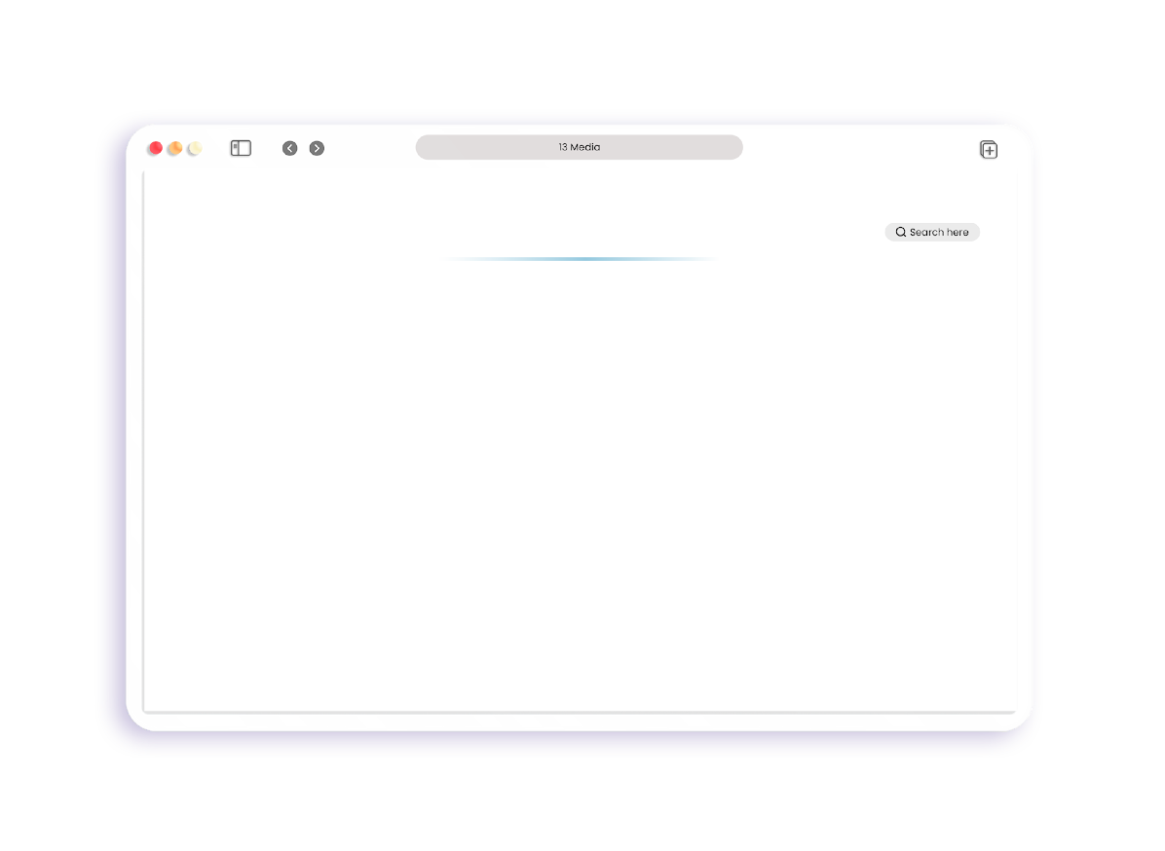




































OUR CLIENTS

